Slide 1

Classification of bow shock and magnetopause event positions by using the Magnetic Field properties of Saturn
MATHEWS PHILIP VENATTU
MSc in DATA SCIENCE AND ANALYTICS
STUDENT ID: 20250487
Dr. KATARINA DOMIJAN
ASST.PROFESSOR
MATHEMATICS AND STATISTICS DEPARTMENT
MAYNOOTH UNIVERSITY

Slide 2
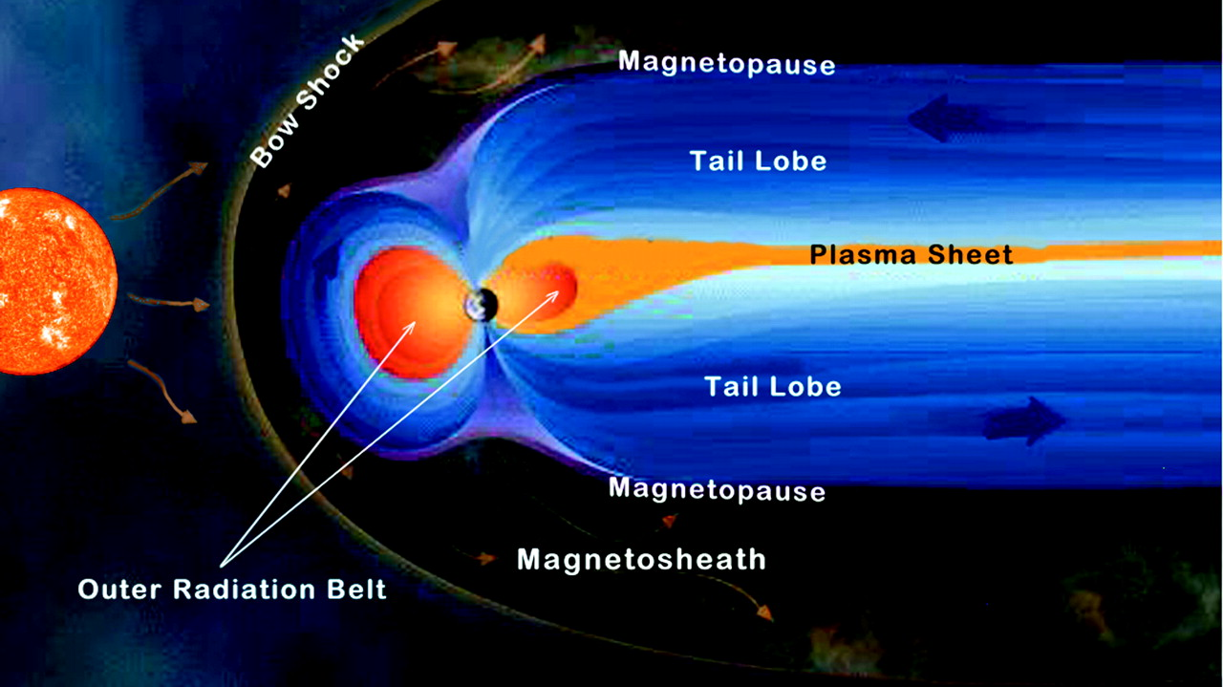
Problem statement
To classify the different boundary crossings of CASSINI Spacecraft by using the Magnetic field properties of Saturn.
By classifying the boundary crossings it will give more insights to the Solar wind conditions upstream of Saturn at the time of crossing.

Slide 3
Data used
Full_Cassini_Master_MP_BS_CMJ_revised2005
It contains list of BS and MP Points at Saturn for the year 2005.
Important Features:
Type of cross: BS, MP, DG and SCAS
Direction of cross: I ,O ,S_SW , E_SW, S_SH, E_SH, S_SP, E_SP
Cassini Magnetometer Dataset
It contains the Cassini magnetometer data for 2005.
Important Features:
Magnetic Field vector data : X_KSM,Y_KSM , Z_KSM, Bx, By , Bz and Btot (all in KSM coordinate system).
Notes:
ss

Slide 4
Data manipulation
Merged the two datasets :
Used Timestamp of both the datasets as the key value for joining.
To identify the Magnetometer readings during different events.
Dimension of data after joining (49452,18)
Imputed all the NA values in type_cross variable as NE (No Events)
Imputed all the NA values in dirn_type variable as UD (Unknown Direction)
Made the data wider
Created columns which contains information of Magnetic field strength of 15 data points before and after an event.
Dimension of data (49452,219)

Slide 5
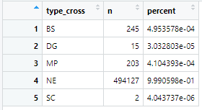
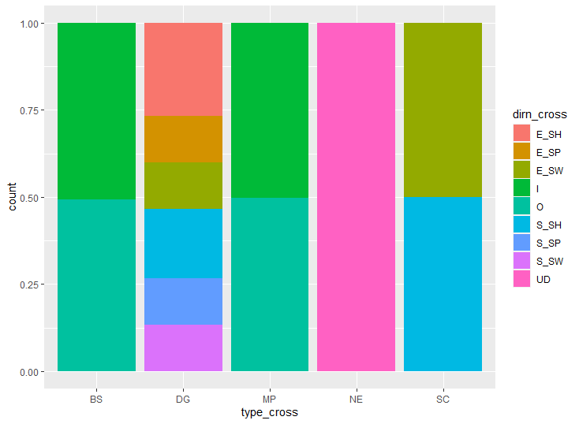
Data Visualization
From Fig 1(a)
Most of the datapoints are in the category of No Events Occurred
From Fig 1(b)
Directions are unknown for the Cross Type of NE.
There are equal number of Inbound and Outbound direction datapoints for the Bow Shock and Magneto Pause events.
Fig 1(a) :Total Counts of Events in Data
Fig 1(b) :Proportion of different directions Events in Data

Slide 6
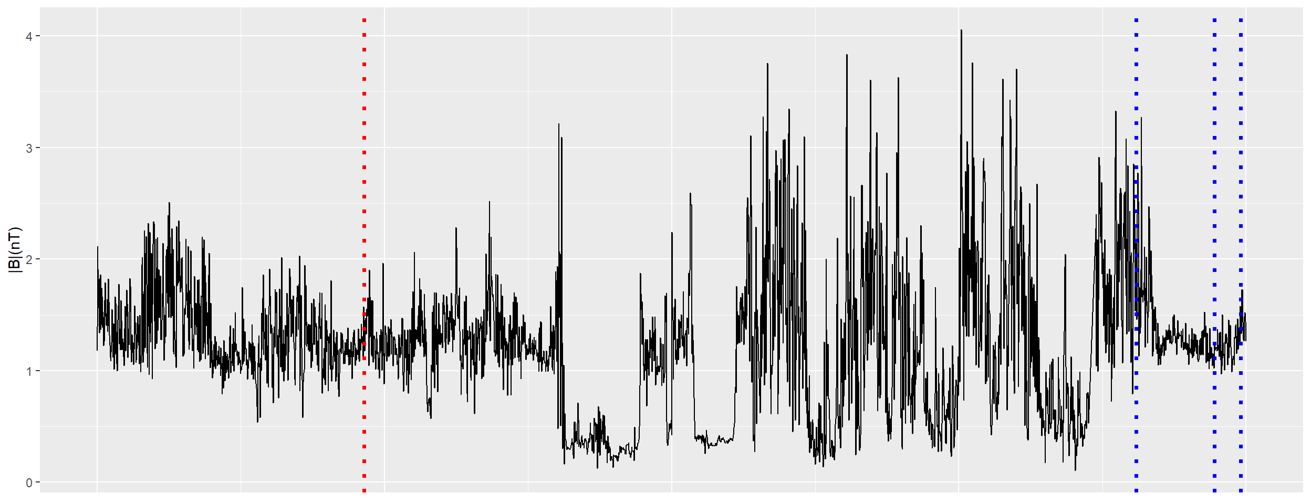
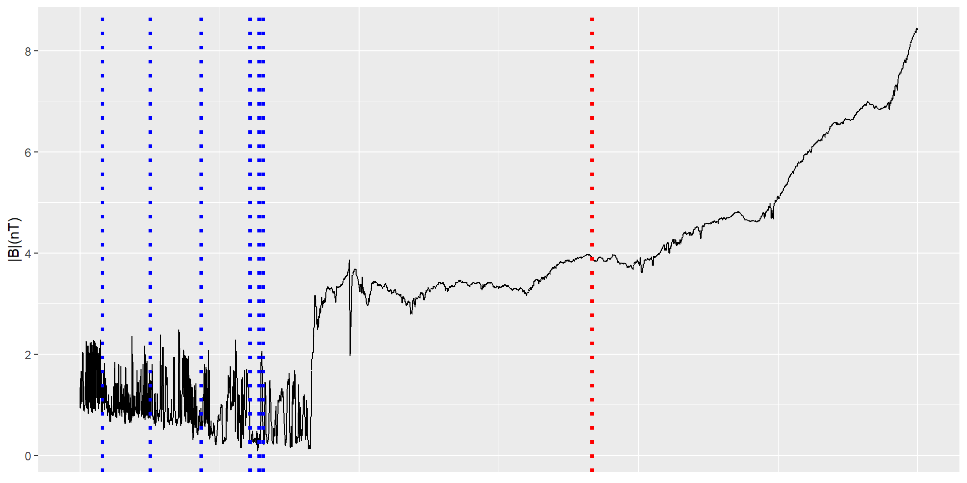
Data visualization
- In both the fig 1(a) and (b)
- Recorded Between the days 72 and 74 ---of the year 2005
- Blue dotted Line: Bow Shock Events
- Red dotted line : Magnetopause events
- Fig 1(a) : The points are recorded when Cassini Spacecraft was in Outbound
-Fig 1(b): The Points are recorded when Cassini Spacecraft is in Inbound
Fig 1(a): Btot vs Timestamp [Outbound]
Fig 1(b): Btot vs Timestamp [Inbound]

Slide 7
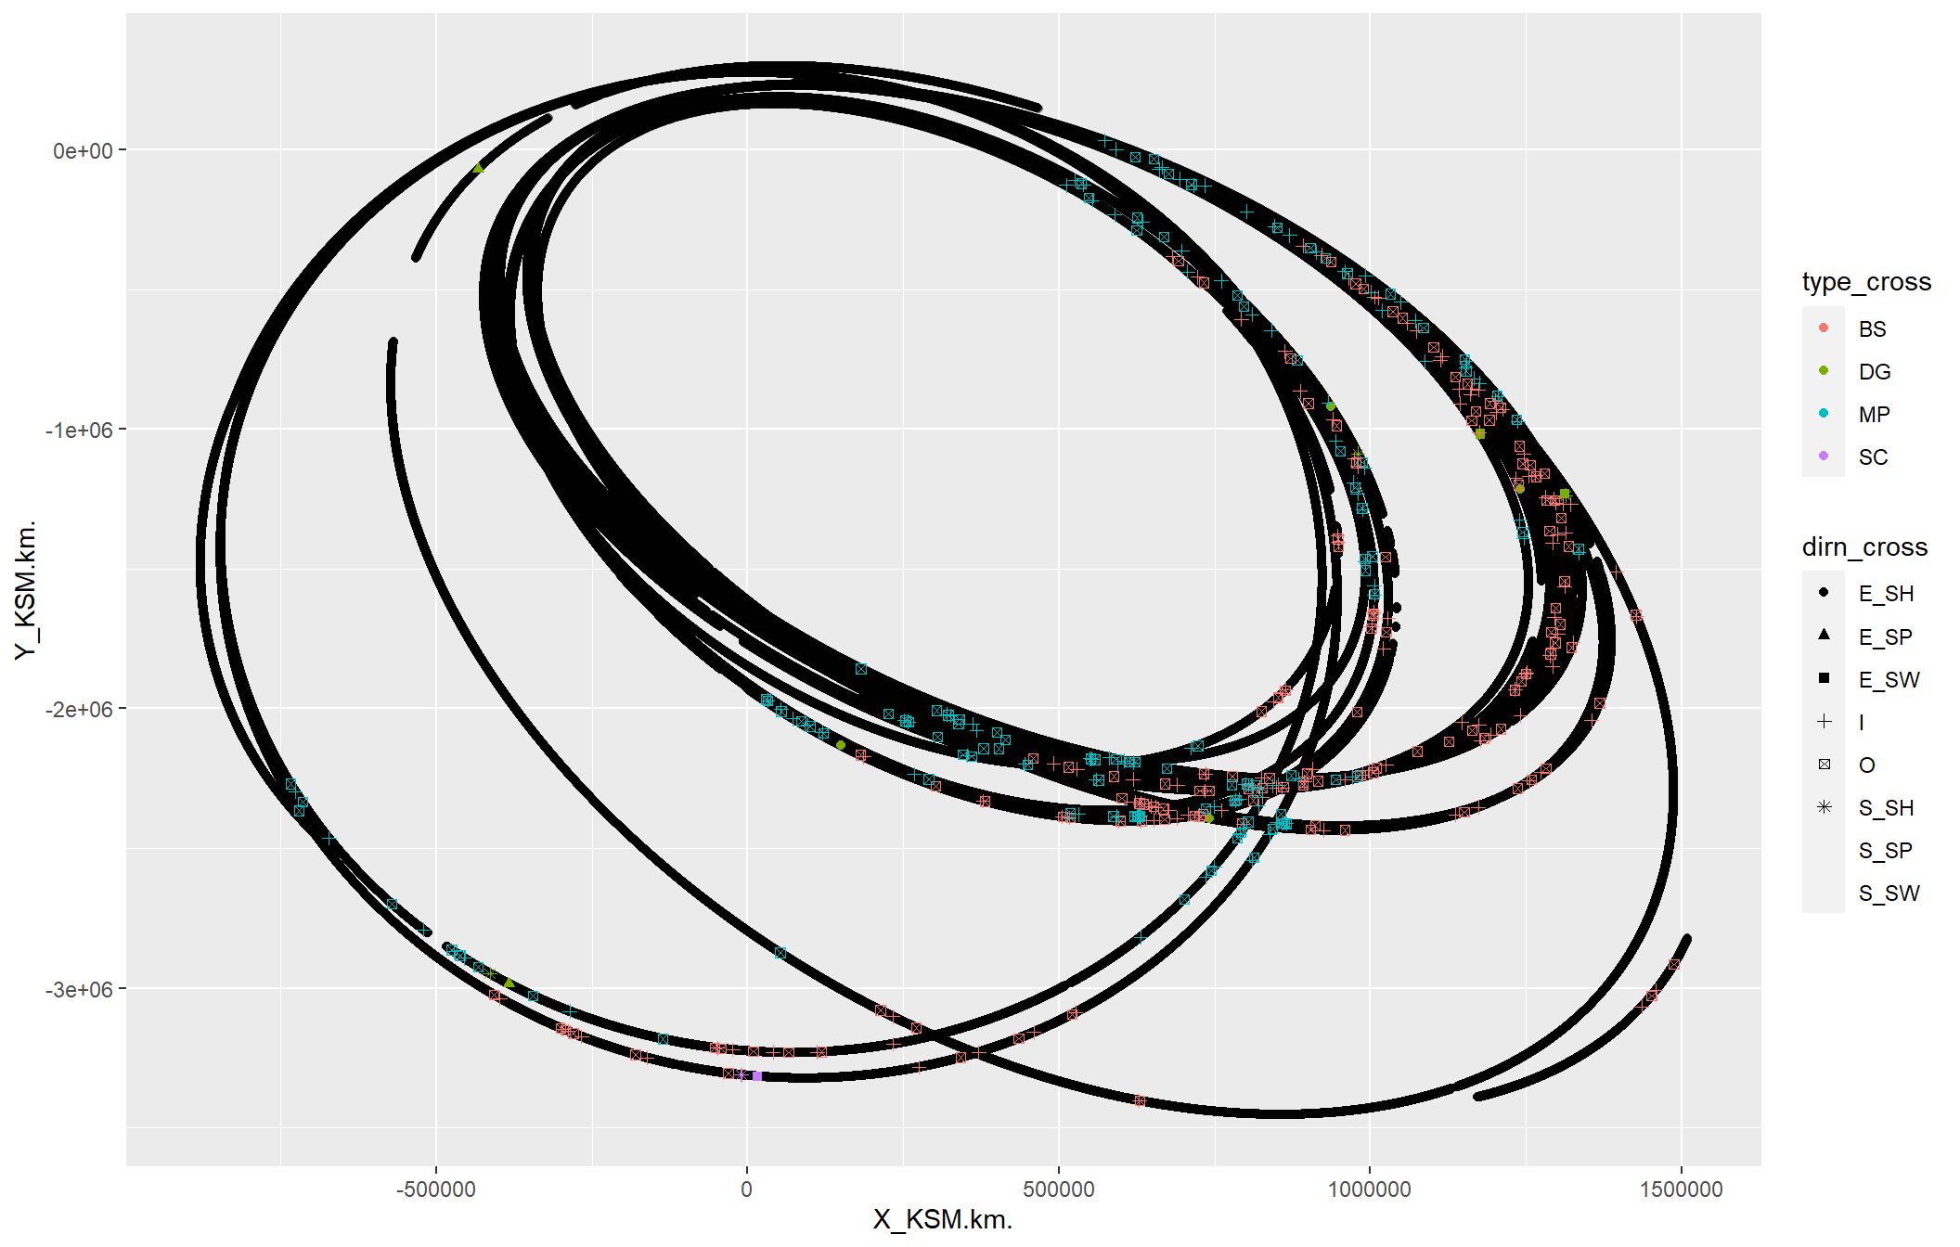
Trajectory of Cassini Spacecraft
KSM Coordinate System was used.
Most of the BS events are occurred in the area where both X and Y are very high.
MP events occurred in the tail of BS events

Slide 8
Classification
For classification two datasets were used which was derived from the main dataset
Dataset 1: A dataset which contains the 500 NE points and remaining occurred events
Dataset 2: A Full Dataset
Test-Training set: 67% - 33% proportion split is used
Models used
Logistic Regression
Trying to classify two categories: Events occurred and No Events Occurred
Random Forrest
Trying to classify all the categories

Slide 9
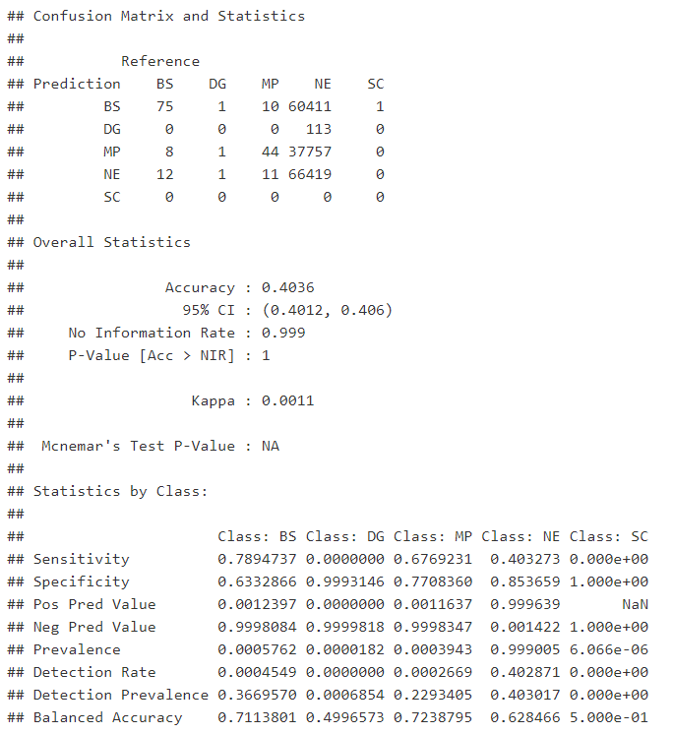
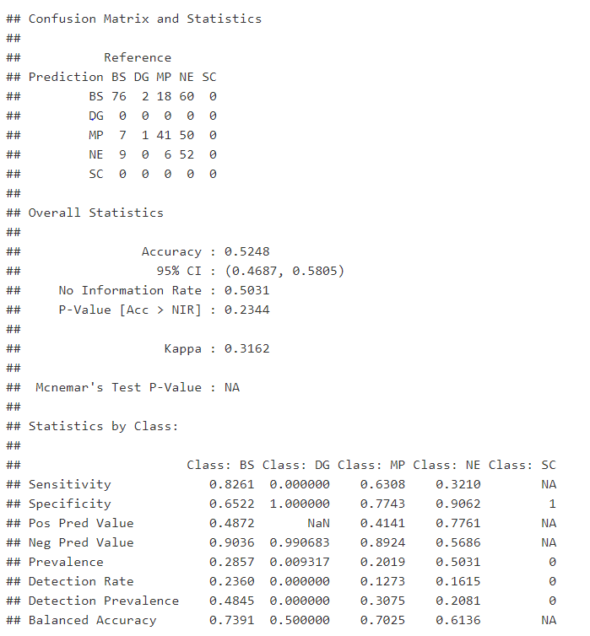
Random Forest
Dataset 1
Accuracy of the model is about 40%
Sensitivity of the BS Class is about 78%
Dataset 2
Accuracy of the model is about 52%
Sensitivity of the BS class is about 82%
Fig 1(a): Confusion Matrix Logistic Regression with Dataset 1
Fig 1(b): Confusion Matrix Logistic Regression with Dataset 2
Notes:
Add Epochs Count

Slide 10
Logistic regression

Slide 12
Conclusion
The dataset contains a highly imbalanced data
Logistic regression model summary shown that all predictors are significant
Random Forest model with dataset 2 has better results than dataset 1

Slide 13
Further work
Classifying the events in dataset by using Neural Networks.
Classifying the regions at which bow shock and magneto pause separate.

Slide 14
THANK YOU

